Slide 1
VLSI DESIGN
Lecture 3
B.E (ECE) 5th semester

Slide 2
Wafer Manufacture
ICs must be fabricated on ultrapure, defect free slices of single crystalline silicon, called wafers.
A wafer is the circular silicon base upon which chips are manufactured.
It is made from an ingot, which is a cylindrical, single-crystal semiconductor typically resulting from the Czochralski crystal growth process.
Wafer production requires three general processes:
Silicon refinement.
Crystal growth.
Wafer formation.

Slide 3
Silicon Refinement
Metallurgical -Grade Silicon (MGS)
1. Silicon refinement begins with the reduction of silica in an arc furnace at roughly 2000 °C with a carbon source.
2. The carbon pulls the oxygen from the SiO2 molecules, thus chemically reducing the oxide to roughly 98% pure silicon, referred to as MGS.
SiO2 (solid) + SiC (solid) Si (solid) + SiO (gas) + CO (gas)

Slide 4
Electronic Grade Silicon (EGS)
Silicon is pulverized and treated with hydrogen chloride (HCl) to form trichloro silane (SiHCl3). The overall reduction is governed by the following equation:
SiHCl3 + H2 Si (solid) + 3HCl (gas)
The EGS, a polycrystalline material of high purity, is the raw material used to prepare device quality, single crystal silicon.

Slide 5
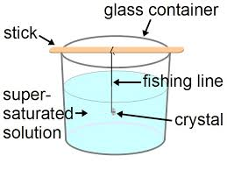
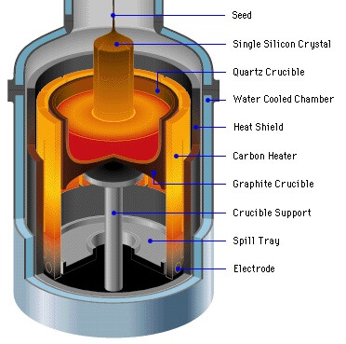
Crystal Growth
The Czochralski Technique

Slide 6
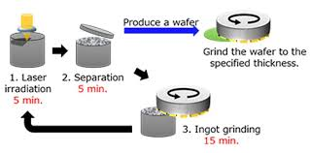
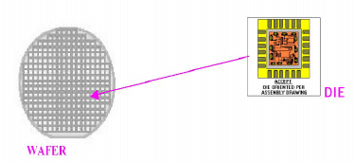
Wafer Formation

Slide 7
Wafer Cleaning
Microfabrication is carried out in clean rooms, where air has been filtered of particle contamination and temperature, humidity, vibrations and electrical disturbances are under stringent control.
Smoke, dust, bacteria and cells are micrometres in size. And their presence will destroy the functionality of a fabricated device.
Clean rooms provide cleanliness but the wafers are also actively cleaned before every critical step.

Slide 8
Wet cleaning steps in solutions
RCA-1 clean in ammonia peroxide solution removes organic contamination and particles.
RCA-2 clean in hydrogen chloride and hydrogen peroxide mixture removes metallic impurities.
Sulphuric acid and hydrogen peroxide mixture removes organics.
Hydrogen fluoride removes native oxide from silicon surface.

Slide 9
Dry -Cleaning methods
Oxygen and Argon plasma treatments to remove unwanted surface layers, or hydrogen bake at elevated temperatures to remove native oxide before epitaxy.

Slide 10
Doping and Impurities
In order to fabricate semiconductor devices, a controlled amount of impurities has to be introduced (doped) selectively into the single crystal wafers.
There are three basic methods for controlling doping of a semiconductor.
1. Epitaxy
2. Diffusion
3. Ion implantation

